Slide 1
Introduction To Programming
Functions and header files

Slide 2
Functions
A function is a subroutine, that will be executed. It can have zero to x arguments and will return the value specified by the declaration. Imagine it as a black box, that takes some variables, does magic to them and returns some result.
It consists of a definition and declaration.

Slide 3
Function declaration
The function declarations are usually stored in header files, corresponding to the source files
Basic syntax: <<return value>> functionName ( <<input arguments>> );
void – returns no value
Int – returns integer value

Slide 4
Function definition
The function definition consists of a function signature (which matches the declaration) and a function body.
A function takes in variables, that are usable within the scope of the function body.
Ideally, a function should do only one ”thing” and the name should express it concisely and unambiguously.

Slide 5
Recursion
A recursive function is a function, that calls itself. A common example is the factorial function.
3! = 3*2*1 = 6

Slide 6
Modular code
In c, code can be modularized by writing the function and type definitions in source files (*.c) and exposing them for use in header files (*.h) – those modules can be used by other source files by including their headers.
When compiling a solution with multiple sources, the syntax is ”gcc -o main main.c func.c” - where main is the name of the resulting binary, and main.c and func.c are the necessary sources

Slide 7
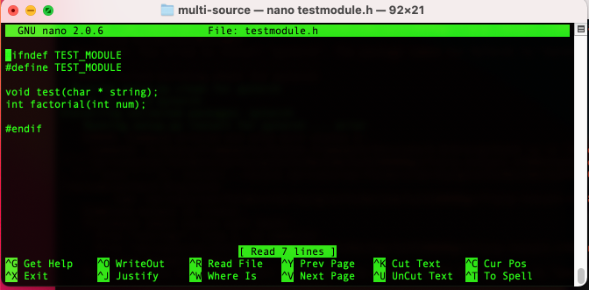
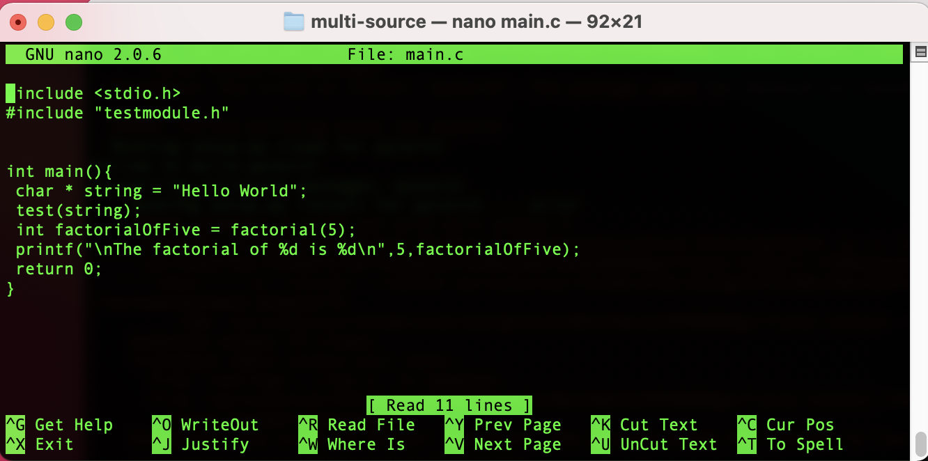
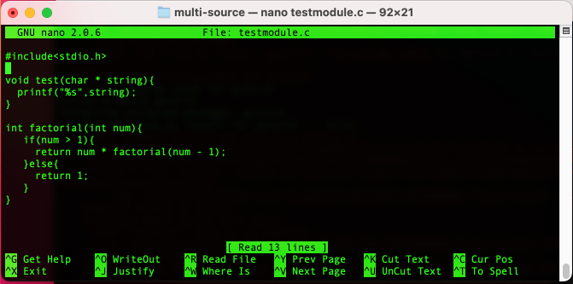
Modular code
The header file declares the functions provided by the module
The main code uses the functions
”test” and “factorial” which are provided
By the module named testmodule,
Imported using the include statement
The source file provides the function implementations

Slide 8
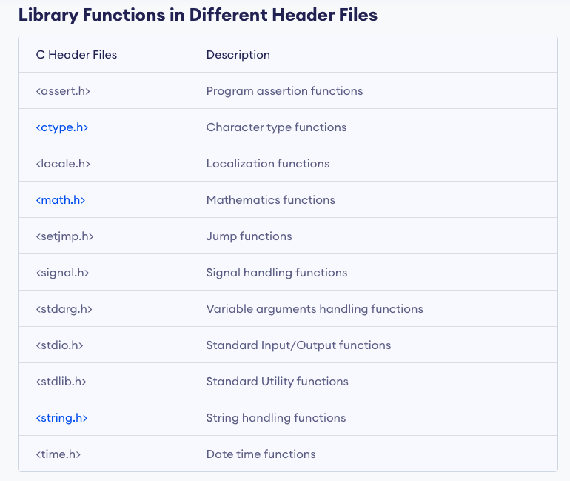
Core modules provided by C

